Slide 1
Chapter 23
Rapid Development
Methodologies

Slide 2
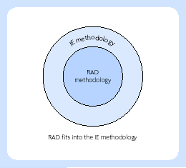
RAD and IE

Slide 3
James Martin’s RAD (JMRAD)
It is not based upon the traditional life cycle, but adopts an evolutionary/prototyping approach
It focuses upon identifying the important users and involving them via workshops at early stages of development
It focuses on obtaining commitment from the business users
It requires a toolset with a sophisticated repository

Slide 4
James Martin’s RAD (JMRAD)
Requirements planning
User design
Construction
Cutover

Slide 5
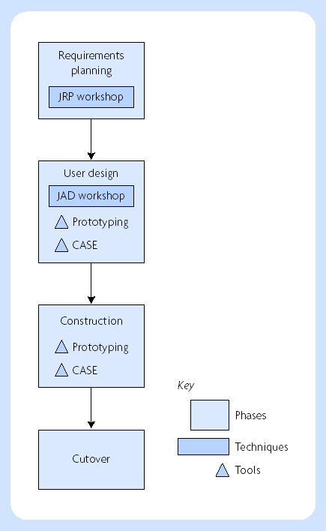
Phases of the RAD approach

Slide 6
Dynamic Systems Development Method (DSDM)
Active user involvement is imperative.
Teams must be empowered to make decisions. The four key variables of empowerment are: authority, resources, information and accountability.
Frequent delivery of products is essential.
Fitness for business purpose is the essential criterion for acceptance of deliverables.
Iterative and incremental development is necessary to converge on an accurate business solution.
All changes during development are reversible, i.e. you do not proceed further down a particular path if problems are encountered, you backtrack to the last safe or agreed point, and then start down a new path.
Requirements are baselined at a high level, i.e. the high-level business requirements, once agreed, are frozen. This is essentially the scope of the project.
Testing is integrated throughout the life cycle, i.e. ‘test as you go’ rather than testing just at the end where it frequently gets squeezed.
A collaborative and co-operative approach between all stakeholders is essential.

Slide 7
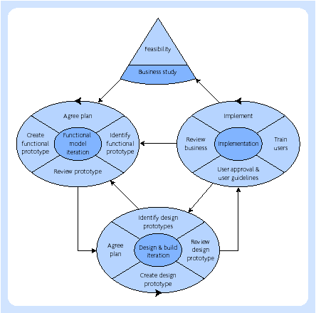
DSDM three pizzas and a cheese diagram

Slide 8
DSDM development lifecycle – five phases
Feasibility study
Business study
Functional model iteration
System design and build iteration
Implementation

Slide 9
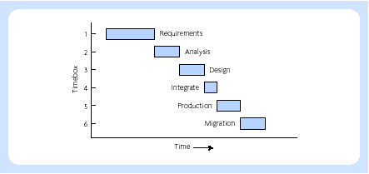
Timeboxes for DSDM project - example

Slide 10
Extreme Programming (XP)
User stories
Architectural spike
Paired programming

Slide 11
Extreme Programming (XP)
Planning
Designing
Developing
Productionalising

Slide 12
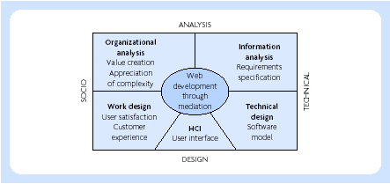
Web IS Development Methodology (WISDM)

Slide 13
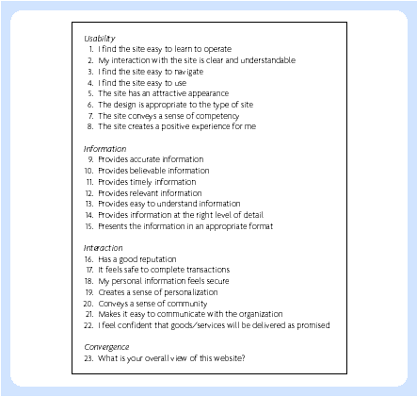
WebQual question

